Slide 1
ISDS 3105 – Group 3
Tanh Trinh, Jason Williams, Buford Dean

Slide 2
Research Questions
How many students had each amount of internships?
i.e. how many had one internship, or two, …
How does the amount of internships affect starting salary?
What is the difference from each level?
How likely are you to get a job related to your major based on amount of internships?

Slide 3
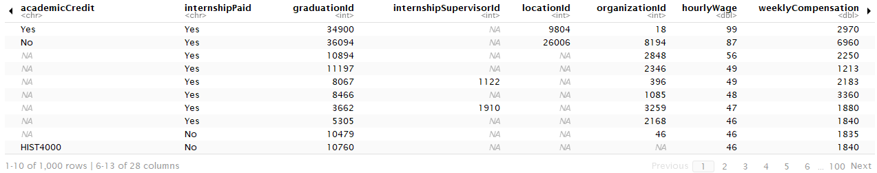
Example Data
We began by querying the database to get relevant information
InternshipID, Job Title, GraduationID, WeeklyCompensation, hourlyWage
In doing so, we found data that was unclean and inconsistent
High hourly wages
Rows with ‘n/a’ for needed values
How did we handle this?

Slide 4
Data Cleanup
We noticed some hourly wages ranging from $50-100/hr
Due to high cost of living? Unlikely?
Due to confusion about hours per week? More likely
How did we handle this?
We removed rows where hourly wage was above $45/h
We removed rows with ‘n/a’ attributes

Slide 5
Why Remove Data?
Though I would normally work with provided data and trust it
Do college grads really want to fill out a survey right after?
Is it actually right to trust the data?
How will it affect our averages for salary?
We believed that our results would be more meaningful if we removed what we saw as outliers

Slide 6
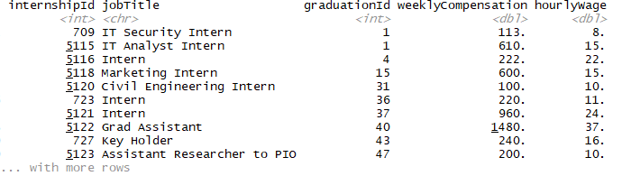
Example of Cleaned Data

Slide 7
Exploring Data: Amount of Internship
Our first task was to see how many students had what amount of internships
Our findings:
Most graduates only had one (by a lot)
About a fourth had two
Around 1/10th had 3

Slide 8
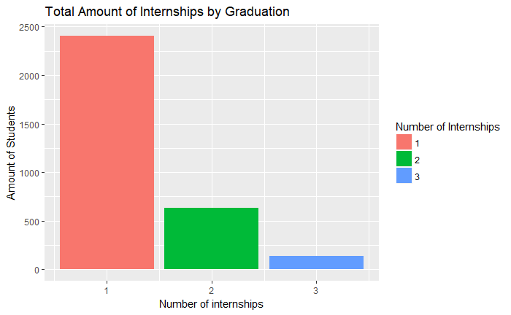
Amount of Internships Visualized
Of course we could describe how many, but lets show you

Slide 9
Exploring Data: Num. Internships vs Salary
Our next task was to compare our previous results with starting salary
Our findings:
The difference in salary between graduates having one and no internships is very small
You will make an extra $1000 on average
There is a substantial increase in salary once you get a second internship
You will make approximately $7000 more than not having an internship
There is a small difference between having two and three internships
You will make about $2500 more (still pretty good)

Slide 10
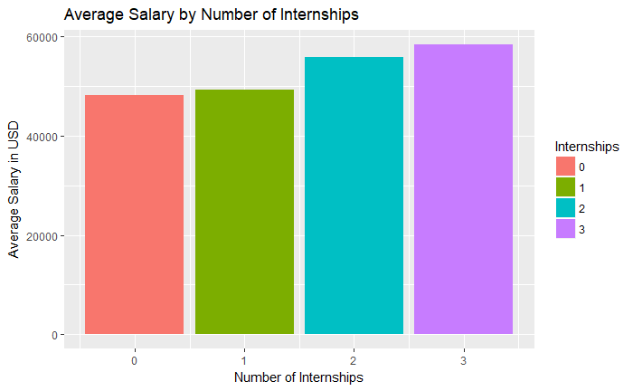
Num. Internships vs Salary Visualized

Slide 11
Exploring Data: Relation to Major
Our last topic was to explore how the amount of internships affects how likely you are to get a job in your major’s field
Our findings:
The major of those with jobs unrelated to their major had no internships
About 80% of those without internships still landed jobs related to their major
First point slightly misleading
Almost all (95% or greater) of those with an internship landed jobs related to their major

Slide 12
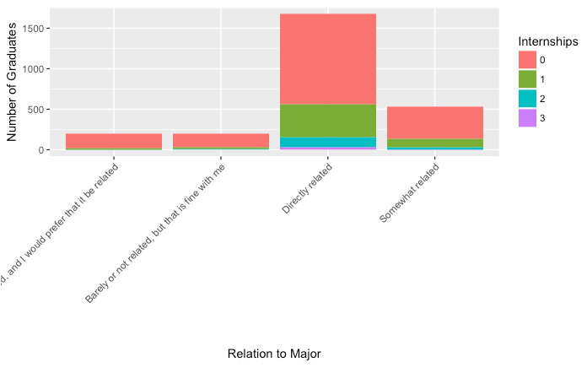
Relation to Major Visualized

Slide 13
The Stakeholders
Which stakeholder does this appeal to?
The schools/departments would be most interested in this study, as their concern is with student placements and starting salaries
What are the takeaways from this study?
Most students end up with jobs related to their major
Having experience is the most important factor in starting salary
Advertising a site like Careers2Geaux more would benefit the students by urging them to get more experience

